Slide 1
Properties of Steam
Why we study properties of steam and steam generating units? To have knowledge on how to produce power/electricity.
How to produce power/electricity? By using kinetic energy of high pressure and temperature steam.
What are the processes involve in producing electricity? Converting one form of power to another form of power by means of working on the systems.
Process in elaboration: Steam kinetic energy is attained in the boiler via fuel which run the steam turbine; kinetic energy is then converted to rotational energy in turbine. The turbine rotor-shaft is coupled with a electro-magnetic generator. Where rotational energy of the shaft converted to electro-magnetism and hence, final product electricity supplied to the grid.
Figure: Structure of energy systems – fossil sources

Slide 2
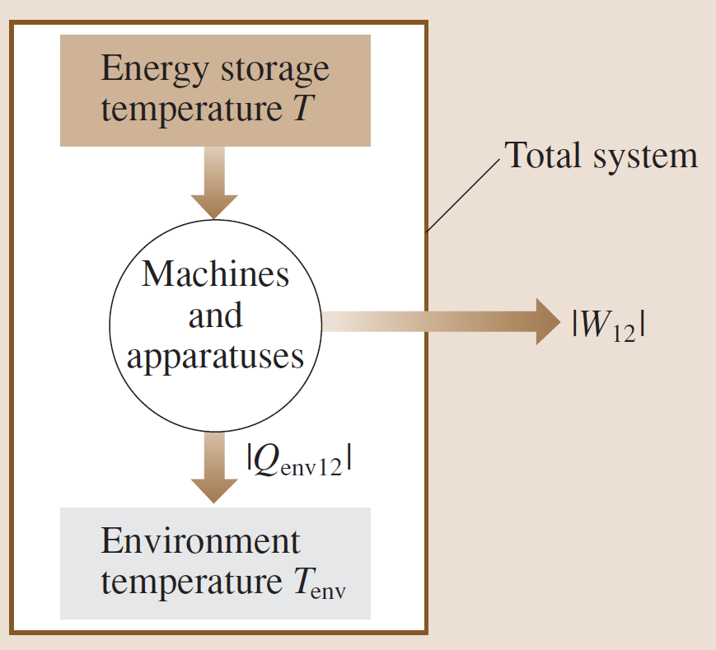
Properties of Steam
-What we know about the thermodynamic properties? When a sample undergoes a heat treatment, it showed change in thermo physical and chemical properties. Such as: phase change, change in thermal equilibrium, degradation process.
-What are the common terminology/units to measure the change in overall properties of a system? Pressure (P), temperature (T), volume (V), change of mass (Δm).
Figure: Conversion of heat into work.

Slide 3
PROPERTIES OF STEAM
Steam is the vapour or gaseous phase of water.
It is produced by heating of water and carries large quantities of heat within itself.
Hence, it could be used as a working substance for heat
engines and steam turbines.
It does not obey ideal gas laws but in superheated state it behaves like an ideal gas.
3

Slide 4
Steam exists in following states or types or conditions.
(i) Wet steam (mixture of dry steam and some water particles) – evaporation of water into steam is not complete.
(ii) Dry steam (dry saturated steam) – all water is completely
converted into dry saturated steam.
(iii) Superheated steam – obtained by further heating of dry saturated steam with increase in dry steam temperature.
4

Slide 5
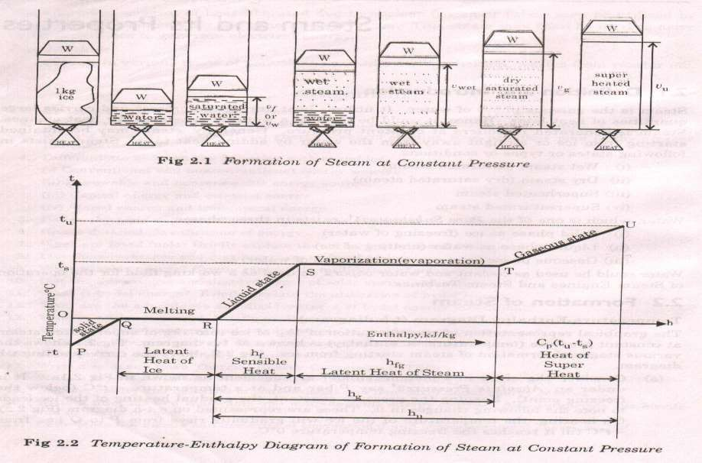
FORMATION OF STEAM
5

Slide 6
ENTHALPY OF STEAM
Enthalpy of liquid or Sensible heat (hf)
It is the amount of heat required to raise the temperature of one kg of water from 0°C to its saturation temperature (boiling point) at constant pressure. (Line R-S)
hf = cpw (tsat – 0) kJ/kg
cpw = 4.187 kJ/kgK = specific heat of water
Enthalpy of Evaporation or Latent heat (hfg)
It is the amount of heat required to change the phase of one kg of water from saturated liquid state to saturated vapour state at constant saturation temperature and pressure. (Line S-T)
Enthalpy of dry saturated steam (hg)
It is the total amount of heat required to generate one kg of dry
saturated steam from water at
0°C. (Line R-S-T)
hg = hf + hfg
5

Slide 7
◻ Enthalpy of wet steam (h)
It is the total amount of heat required to generate one kg of wet steam having dryness fraction x from water at 0°C. It is the sum of sensible heat and latent heat taken by the dry part (x) of the wet steam.
h = hf + x(hfg)
◻ Enthalpy of superheated steam (hsup)
It is the total amount of heat required to generate one kg of superheated steam at required superheat temperature from water at 0°C. Superheated steam behaves like an ideal gas and obeys gas laws. (Line R-S-T-U)
hsup = hf + hfg + cps (Tsup – Tsat)
hsup = hg + cps (Tsup – Tsat)
cps = 2.1 kJ/KgK = specific heat of superheated steam
◻ Heat of superheat
Amount of heat required to get superheated steam from dry saturated
steam is called heat of superheat. (Line T-U) Heat of superheat = cps (Tsup – Tsat) kJ/Kg
6

Slide 8
◻ Degree of superheat
It is the temperature difference between superheated steam and dry saturated steam.
Degree of superheat = (Tsup – Tsat)
◻ Dryness Fraction of Saturated Steam (x )
It is a measure of quality of wet steam. It is the ratio of the mass of dry steam (ms) to the mass of total wet steam (ms+mw), where mw is the mass of water particles in suspension.
x = ms/( ms+mw)
◻ Quality of Steam
It is the representation of dryness fraction in percentage: Quality of Steam =
100(x)
◻ Wetness Fraction
It is the ratio of the mass of water vapor (mw) to the mass of total wet steam (ms +mw)
Wetness fraction = mw/( ms+mw) = (1-x)
◻ Priming
It is the wetness fraction expressed in percentage.
Priming = (1 - x) 100
7

Slide 9
◻ SPECIFIC VOLUME OF STEAM
It is the volume occupied by steam per kg of its mass.
Specific volume of dry steam (vg) : Its value can be obtained directly from the steam tables
Specific volume of wet steam (v) : v = x (vg)
Specific volume of superheated steam (vsup): vsup = vg (Tsup/Tsat)
INTERNAL ENERGY OF STEAM:
h = u + Pv
u = h – Pv
P = Pressure of steam
v = Specific volume of steam
ug = hg – P(vg) for dry saturated steam u = h – P (v) for wet steam
usup = hsup – P(vsup) for superheated steam

Slide 10
Calorimeters
Calorimeters are used for measurement of dryness fraction
of steam.

Slide 11
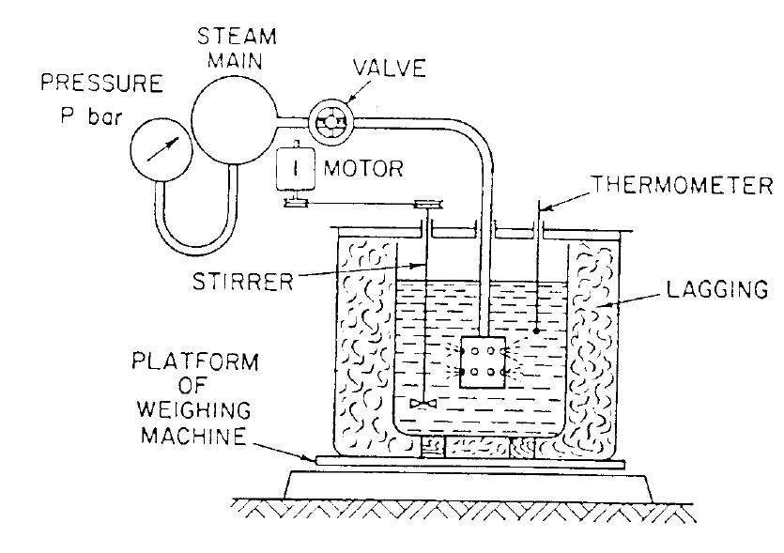
Barrel Calorimeter

Slide 12
Let
mb =mass of the barrel (kg)
mw =mass of the water before the steam goes in (kg)
ms= mass of stem condensed (kg)
T1= temperature of the water before the steam goes in (oc)
T2 =temperature of the water after the steam goes in (oc)
Cb= relative heat capacity of the metal of the barrel (no units)
hf =specific enthalpy of the saturated liquid (steam) (kJ/kg)
hfg =specific enthalpy of the evaporar of steam(kJ/kg)
x =dryness fraction (no units)
hf1= specific enthalpy of the water at temperature T1 (kJ/kg)
Hf2= specific enthalpy of the water at temperature T2 (kJ/kg)

Slide 13
Here known amount of water is filled in the calorimeter. Then certain quantity of steam from the main pipe is taken into the calorimeter.
Steam and water mixes together and so condensation of steam takes place and mass of water in the calorimeter increases.
Latent and sensible heat of steam is given to water and its temperature will increase.

Slide 14
Amount of heat lost by steam = Heat gain by water and calorimeter
ms(hf1+xhfg-hf2)=mb.cb(t2-t1)+mw.cpw(t2-t1)
•
•
=(mb.cb+mwcpw)(t2-t1)
=((mb × cb)/cpw +mw)(t2-t1)cPW
(mb × cb)/cpw = water equi. Calorimeter
Limitation
1)method is not accurate
2)losses are more at higher temp. diff.

Slide 15
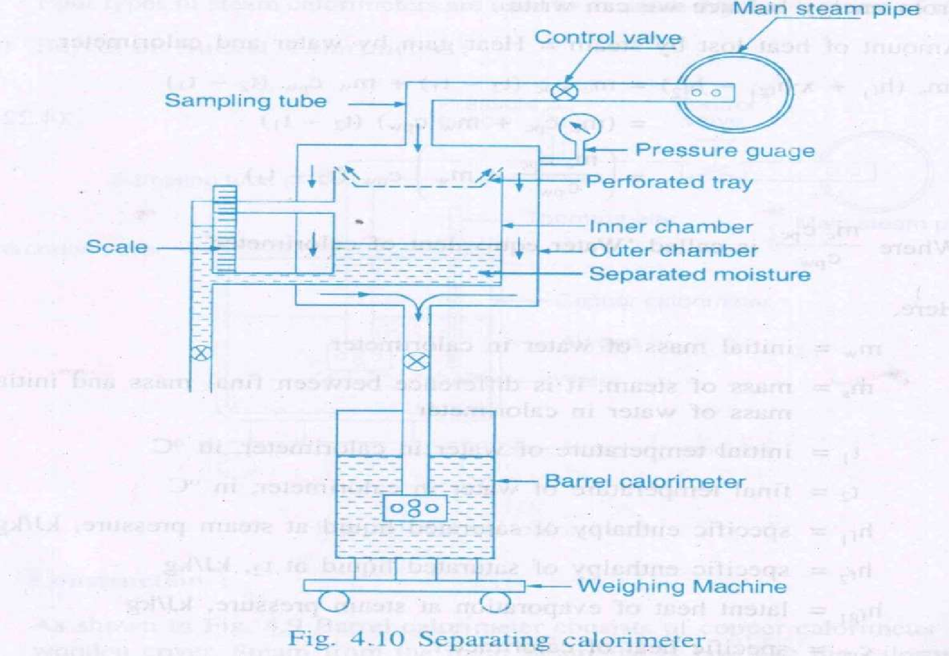
Separating Calorimeter

Slide 16
In this type of calorimeter water particles from the steam are separated first in the inner chamber and its mass mw can be measured.
The dry steam is then condensed in the barrel calorimeter and its mass ms can be calculated from the difference in mass of water of barrel
calorimeter.
So dryness fraction x = ms/(ms + mw)
Limitation: It gives approximate value of x as total separation of water particles from the steam is not possible by mechanical means.

Slide 17
Throttling Calorimeter
Throttling
A throttling process is one in which the fluid is made to flow through a restriction,
e.g. a partially opened valve or an orifice plate, causing a
considerable loss in the pressure of the fluid.

Slide 18
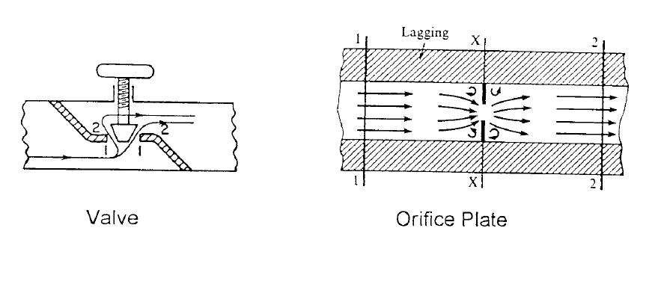

Slide 19
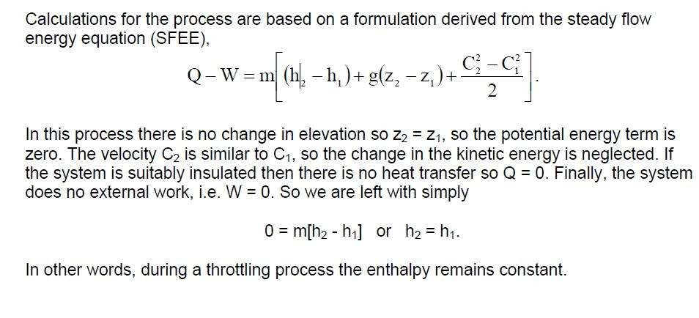

Slide 20
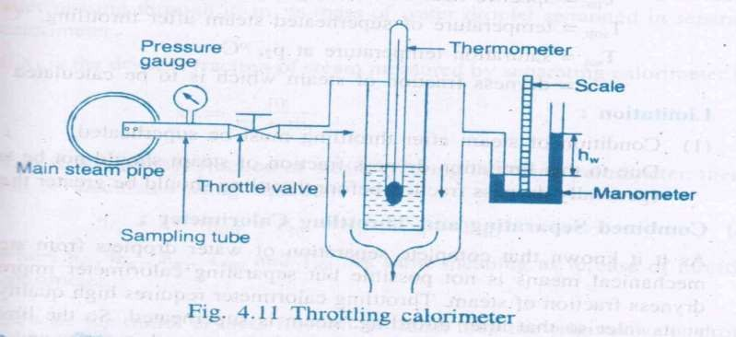
Throttling Calorimeter

Slide 21
In this calorimeter a throttling valve is used to throttle the
steam.
The pressure of steam reduces after throttling. Pressure and temperature of steam before and after throttling is measured.
Enthalpy of steam before and after throttling remains
constant.
To measure dryness fraction condition of steam after throttling must be superheated steam.
Enthalpy of stem before throttling = Enthalpy of stem after
throttling
hf1+xhfg1=hf2+hfg2+Cps(Tsup – T sat)
x= (hg2+Cps(Tsup – T sat) – hf1)/hfg1
Limitation: Steam must become superheated after throttling. That means it is not very useful for steam containing more amount of water particles.
20

Slide 22
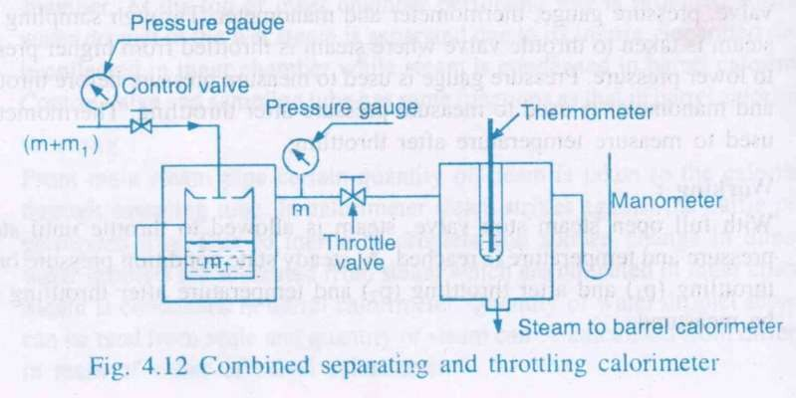
Combined Separating and Throttling Calorimeter

Slide 23
The limitations of separating and throttling calorimeters can be overcome if they are
used in series as in this type of calorimeter.
It gives accurate estimation of dryness fraction.
x = x1. x2
x1 = dryness fraction of steam measured from separating calorimeter.
x2 = dryness fraction of steam measured from throttling
calorimeter.

Slide 24
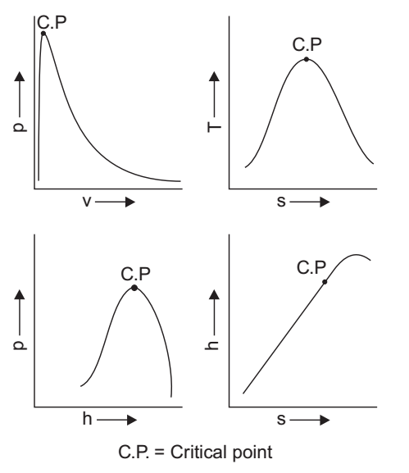
PROPERTY DIAGRAMS IN COMMON USE

Slide 25
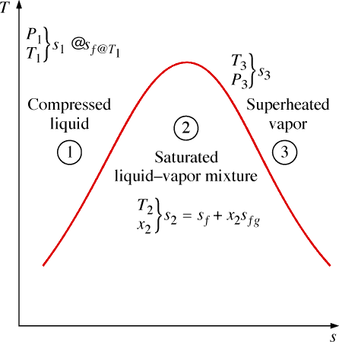
The entropy of a pure substance is determined from the tables, just as for any other property

Slide 26
Ts Diagram for Water

Slide 27
Pure substance and phase
All substance is composed of numerous numbers of particles known as molecules. Pure substance is defined as substance that is made of only one type of atom or only one type of molecule. Its chemical composition is uniform and remains invariant during heating or work transfer with the surroundings. Such as water, diamond, ice, nitrogen, oxygen, gold etc.
Phases
Solid,
Liquid and
Gas

Slide 28
Properties and important definitions
Boiling point: It is defined as that point (temperature) in the system at which
vapour pressure equals to the atmospheric pressure and at point (temperature) phase transfer from liquid to gas (vapours) takes place.
Melting point: It is defined as that point (temperature) in the system at which
phase transfer from solid to liquid takes place.
Saturation point: It is defined as that point at which phase transfer takes place without any change in pressure and temperature.
Saturation pressure: It is defined as that pressure at which phase transfer
takes place at constant temperature. Such as at any given temperature water
will be converted into steam at a definite temperature only. Such as boiling
point of water is 100ºC at 1 atm pressure and 122ºC at 2.1 atm pressure. So that 1 atm and 2.1 atm will be the saturation pressure.
Saturation temperature: It is defined as that temperature at which phase
transfer takes place at constant pressure. Such as saturation temperature of
water at 1atm pressure is 100ºC.
Triple point: It is defined as that point in the system at which all the phases (solid, liquid and gas) exists in equilibrium.

Slide 29
Sensible heat of water: It is defined as the amount of heat absorbed by one kilogram of water, when heated at constant pressure, from 0ºC (freezing point) to saturation temperature (formation of steam). It is also known as liquid heat.
Latent heat of vaporization: It is defined as the amount of heat required to evaporated one kilogram of water at its saturation temperature (boiling point) without change of temperature. It is represented by h_{fg}. Its unit is kJ/kg. The latent heat of vaporization of water or latent heat of steam is 2257 kJ/kg. If the steam is wet with a dryness fraction x, then the heat absorbed by wet steam is xh_{fg}.
ℎ_{𝑓𝑔} = (ℎ_{𝑔}−ℎ_{𝑓})
Enthalpy: It is defined as the amount of heat absorbed by water from 0ºC (freezing point) to saturation point (sensible heat) plus heat absorbed during evaporation (latent heat). It is represented by h_{g}.
So that,
𝐸𝑛𝑡ℎ𝑎𝑙𝑝𝑦 = 𝑠𝑒𝑛𝑠𝑖𝑏𝑙𝑒 ℎ𝑒𝑎𝑡 + 𝑙𝑎𝑡𝑒𝑛𝑡 ℎ𝑒𝑎𝑡

Slide 30
Steam is a vapour of water, and is invisible when pure and dry. It is used as a working substance in the operation of steam engines and steam turbines. It obeys the laws of gases, when it is perfectly dry.
Terminology for steam
Steam
Wet steam: When the steam contains moisture or particles of water, it is termed as wet steam.
Dry saturated steam: When the steam does not contain any moisture or suspended particles of water, it is termed as dry saturated steam. It is obtained when the wet steam is further heated.
Superheated steam: When the dry saturated steam is further heated at constant pressure thus raising its
temperature, it is termed as superheated steam. Because heating of steam at constant pressure therefore
volume of superheated steam increases. It may be noted that the volume of 1 kg of superheated steam is greater than the volume of 1 kg of dry saturated steam.
Dryness fraction: It is the ratio of the actual mass of dry steam to the mass of same quantity of wet
steam. It is represented by x. Mathematically it is written as,
𝑥 = _{𝑚}
𝑚_{𝑔} 𝑚_{𝑔}
+ 𝑚
= _{𝑚}
𝑔 𝑓 𝑤
Where,
𝑚_{𝑔} = 𝑎𝑐𝑡𝑢𝑎𝑙 𝑚𝑎𝑠𝑠 𝑜𝑓 𝑑𝑟𝑦 𝑠𝑡𝑒𝑎𝑚
𝑚_{𝑓} = 𝑚𝑎𝑠𝑠 𝑜𝑓 𝑤𝑎𝑡𝑒𝑟
𝑚_{𝑤} = 𝑚𝑎𝑠𝑠 𝑜𝑓 𝑤𝑒𝑡 𝑠𝑡𝑒𝑎𝑚 = (𝑚_{𝑔}+𝑚_{𝑓})

Slide 31
Some expressions for enthalpy,
Wet steam: Enthalpy of wet steam is given by;
ℎ = ℎ_{𝑓} + 𝑥ℎ_{𝑓𝑔}
Dry steam: Enthalpy of dry steam is given by;
ℎ = ℎ_{𝑔} = ℎ_{𝑓} + ℎ_{𝑓𝑔} … … … … 𝑠𝑖𝑛𝑐𝑒 𝑥 = 1 𝑓𝑜𝑟 𝑑𝑟𝑦 𝑎𝑖𝑟.
Superheated steam: From the definition superheated steam it may be written as,
ℎ_{𝑠𝑢𝑝} = 𝑡𝑜𝑡𝑎𝑙 ℎ𝑒𝑎𝑡 𝑓𝑜𝑟 𝑑𝑟𝑦 𝑠𝑡𝑒𝑎𝑚 + ℎ𝑒𝑎𝑡 𝑓𝑜𝑟 𝑠𝑢𝑝𝑒𝑟ℎ𝑒𝑎𝑡𝑒𝑑 𝑠𝑡𝑒𝑎𝑚
^{ℎ}𝑠𝑢𝑝 ^{= ℎ}𝑓
+ ℎ_{𝑓𝑔} + 𝑐_{𝑝}(𝑇_{𝑠𝑢𝑝} − 𝑇)
ℎ_{𝑠𝑢𝑝} = ℎ_{𝑔} + 𝑐_{𝑝}(𝑇_{𝑠𝑢𝑝} − 𝑇)
Where,
𝑐_{𝑝} = 𝑠𝑝𝑒𝑐𝑖𝑓𝑖𝑐 ℎ𝑒𝑎𝑡 𝑎𝑡 𝑐𝑜𝑛𝑠𝑡𝑎𝑛𝑡 𝑝𝑟𝑒𝑠𝑠𝑢𝑟𝑒
𝑇_{𝑠𝑢𝑝} = 𝑡𝑒𝑚𝑝𝑒𝑟𝑎𝑡𝑢𝑟𝑒 𝑜𝑓 𝑠𝑢𝑝𝑒𝑟ℎ𝑒𝑎𝑡𝑒𝑑 𝑠𝑡𝑒𝑎𝑚
𝑇 = 𝑠𝑎𝑡𝑢𝑟𝑎𝑡𝑖𝑜𝑛 𝑡𝑒𝑚𝑝𝑒𝑟𝑎𝑡𝑢𝑟𝑒 𝑎𝑡 𝑐𝑜𝑛𝑠𝑡𝑎𝑛𝑡 𝑝𝑟𝑒𝑠𝑠𝑢𝑟𝑒.

Slide 32
Specific volume: It is the volume occupied by the steam per unit mass at given
temperature and pressure. It is represented by v. It is expressed in m³/kg. The reciprocal of specific volume represents the density.
Some expressions for volumes occupied by the steam,
Wet steam: Consider one kilogram of wet steam of dryness fraction x. It means
that this steam will have x kg of dry steam and (1-x) kg of water. Let v_{f} be the
volume of one kg of water then, volume of one kilogram of wet steam is given by,
= 𝑥𝑣_{𝑔} + (1 − 𝑥)𝑣_{𝑓}
Since v_{f} is very small in comparison to v_{g}, so the term (1 − 𝑥)𝑣_{𝑓} may be neglected.
So that,
Volume of one kilogram of wet steam
= 𝑥𝑣_{𝑔} m³
Or Specific volume of wet steam
𝑣 = 𝑥𝑣_{𝑔} m³/kg

Slide 33
Dry steam: As studied earlier in dry steam, the mass of water is zero and dryness
fraction is unity. So that
Specific volume of dry steam
𝑣 = 𝑣_{𝑔} m³/kg
Superheated steam: As studied earlier when the dry saturated steam is further
heated at constant pressure thus raising its temperature, it is termed as superheated
steam. Because heating of steam at constant pressure therefore volume of superheated steam increases. According to Charles’s law
^{𝑣}𝑠𝑢𝑝
𝑣_{𝑔}
= _{𝑇}
𝑇
𝑠𝑢𝑝
Or
^{𝑣}𝑔.^{𝑇}𝑠𝑢𝑝
^{𝑣}𝑠𝑢𝑝 ⁼
𝑇
Where,
𝑣_{𝑠𝑢𝑝} = 𝑠𝑝𝑒𝑐𝑖𝑓𝑖𝑐 𝑣𝑜𝑙𝑢𝑚𝑒 𝑜𝑓 𝑠𝑢𝑝𝑒𝑟ℎ𝑒𝑎𝑡𝑒𝑑 𝑠𝑡𝑒𝑎𝑚
𝑇_{𝑠𝑢𝑝} = 𝑡𝑒𝑚𝑝𝑒𝑟𝑎𝑡𝑢𝑟𝑒 𝑜𝑓 𝑠𝑢𝑝𝑒𝑟ℎ𝑒𝑎𝑡𝑒𝑑 𝑠𝑡𝑒𝑎𝑚
𝑣_{𝑔} = 𝑠𝑝𝑒𝑐𝑖𝑓𝑖𝑐 𝑣𝑜𝑙𝑢𝑚𝑒 𝑜𝑓 𝑑𝑟𝑦 𝑠𝑎𝑡𝑢𝑟𝑎𝑡𝑒𝑑 𝑠𝑡𝑒𝑎𝑚
𝑇 = 𝑠𝑎𝑡𝑢𝑟𝑎𝑡𝑖𝑜𝑛 𝑡𝑒𝑚𝑝𝑒𝑟𝑎𝑡𝑢𝑟𝑒.

Slide 34
Internal energy: Internal energy of steam is define as the energy stored
in the steam, above 0ºC (freezing point) of water. It may be obtained by
subtracting the work done during evaporation to the enthalpy of steam. It is represented by U. Mathematically it is written as,
𝐼𝑛𝑡𝑒𝑟𝑛𝑎𝑙 𝑒𝑛𝑒𝑟𝑔𝑦 𝑜𝑓 𝑠𝑡𝑒𝑎𝑚
= 𝐸𝑛𝑡ℎ𝑎𝑙𝑝𝑦 𝑜𝑓 𝑠𝑡𝑒𝑎𝑚 − 𝑊𝑜𝑟𝑘𝑑𝑜𝑛𝑒 𝑑𝑢𝑟𝑖𝑛𝑔 𝑒𝑣𝑎𝑝𝑜𝑟𝑎𝑡𝑖𝑜𝑛
Some expressions for enthalpy,
Wet steam: Internal energy of wet steam is given by;
𝑈 = ℎ − 100 ∗ 𝑃 ∗ 𝑥 ∗ 𝑣_{𝑔} = ℎ_{𝑓} + 𝑥ℎ_{𝑓𝑔} − 100 ∗ 𝑃 ∗ 𝑥 ∗ 𝑣_{𝑔} 𝑘𝐽/𝑘𝑔
Dry steam: Internal energy of dry steam is given by;
𝑈 = ℎ_{𝑔} − 100 ∗ 𝑃 ∗ 𝑣_{𝑔} 𝑘𝐽/𝑘𝑔 … … … … 𝑠𝑖𝑛𝑐𝑒 𝑥 = 1 𝑓𝑜𝑟 𝑑𝑟𝑦 𝑎𝑖𝑟.
Superheated steam: From the definition superheated steam it may be written as,
𝑈 = ℎ_{𝑠𝑢𝑝} − 100 ∗ 𝑃 ∗ 𝑣_{𝑔}
𝑈 = ℎ_{𝑔} + 𝑐_{𝑝} 𝑇_{𝑠𝑢𝑝} − 𝑇 − 100 ∗ 𝑃 ∗ 𝑣_{𝑠𝑢𝑝} 𝑘𝐽/𝑘𝑔

Slide 35
Steam Table and its use
Temperature based
Temperature in ºC | Absolute pressure in bar | Specfic volume in m³/kg |  | Specific enthalpy in kJ/kg |  |  | Specific entropy in kJ/kg K
(T) | (P) | water (v_{f}) | steam (v_{g}) | water (h_{f}) | Evaporation (h_{fg}) | steam (h_{g}) | water (s_{f}) | Evaporation (s_{fg}) | steam (s_{g})
1 | 0.00657 | 0.001000 | 192.61 | 4.2 | 2499.2 | 2503.4 | 0.015 | 9.116 | 9.131
15 | 0.01704 | 0.001001 | 77.978 | 62.9 | 2466.1 | 2529.1 | 0.224 | 8.559 | 8.783
20 | 0.02337 | 0.001002 | 57.838 | 83.9 | 2454.3 | 2538.2 | 0.296 | 8.372 | 8.668
Pressure based
Absolute pressure in bar | Temperature in ºC | Specfic volume in m³/kg |  | Specific enthalpy in kJ/kg |  |  | Specific entropy in kJ/kg K
(P) | (T) | water (v_{f} ) | steam (v_{g}) | water (h_{f}) | Evaporation (h_{fg}) | steam (h_{g}) | water (s_{f}) | Evaporation (s_{fg}) | steam (s_{g})
0.035 | 26.69 | 0.001003 | 39.479 | 111.8 | 2438.6 | 2550.4 | 0.391 | 8.132 | 8.523
0.060 | 36.18 | 0.001006 | 23.741 | 151.5 | 2416.0 | 2567.5 | 0.521 | 7.810 | 8.331
0.090 | 43.79 | 0.001009 | 16.204 | 183.3 | 2397.8 | 2581.1 | 0.622 | 7.566 | 8.188

Slide 36
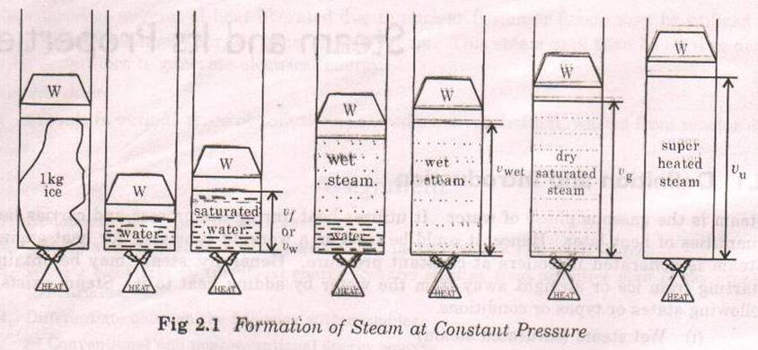
Steam – Water - Ice
Generation of steam at constant pressure
Consider 1 kg of ice in a piston -cylinder arrangement as shown.
it is under an Absolute Pressure say P bar and at temperature
–t 0 C ( below the freezing point).

Slide 37
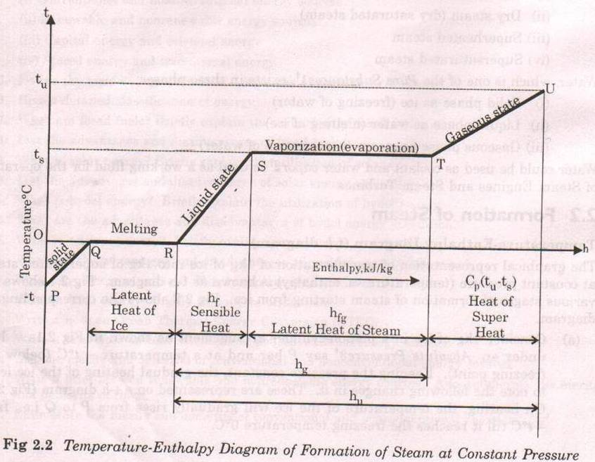
Keeping the pressure constant, the gradual heating of the ice
leads to note the following changes in it, These are represented
on a t-h diagram on heating, the temperature of the ice will
gradually rises from p to Q i.e from – t C till reaches the freezing
temperature 0.

Slide 38
Adding more heat, the ice starts melting without changing in the temperature till the entire ice is converted into water from Q to R. The amount of heat during this period from Q to R is called Latent heat of fusion of ice or simply Latent heat of ice.

Slide 39
Continuous heating raises the temperature to its boiling point t C known as Saturation Temperature. The corresponding pressure is called saturation pressure. it is the stage of vaporization at 1.01325 bar atmospheric pressure (760mm of hg at 100'C).

Slide 40
As pressure increases, the value of saturation temperature also increases. The amount of heat added during R to S is called Sensible Heat or Enthalpy of Saturated Water or Total Heat of Water (h, or h "' ).

Slide 41
During the process, a slight increase in volume of water (saturated water) may be noted. The resulting volume is known as Specific volume of Saturated Water (Vf or vW).

Slide 42
On further heating beyond S, the water will gradually starts evaporate and starts convert it to steam, but the temperature remains constant. As long as the steam is in contact with water, it is called Wet Steam or Saturated Steam.

Slide 43
(e) On further heating the temperature remains constant, but the entire water converts to steam. But still it will be wet steam. The total heat supplied from OOC is called Enthalpy of Wet Steam (h wet). The resulting volume is known as Specific Volume of Wet Steam (v wet)

Slide 44
(f) On further heating the wet steam, the water particles, which are in suspension, will start evaporating gradually and at a particular moment the final particles just evaporates. The steam at that moment corresponding to point T is called Dry Steam or Dry Saturated Steam.

Slide 45
The resulting volume is known as Specific Volume of Dry Steam (vg). This steam not obeys the gas laws. The amount of heat added during S to T is called Latent Heat of Vaporization of Steam or Latent Heat of Steam (hfg). During the process, the saturation temperature remains constant.

Slide 46
The total heat supplied from O'C is called Enthalpy of Dry Steam (hg).
(g) On further heating beyond point T to U the temperature starts from ts to tu, the point of interest. This process is called Super heating. The steam so obtained is called Super Heated Steam

Slide 47
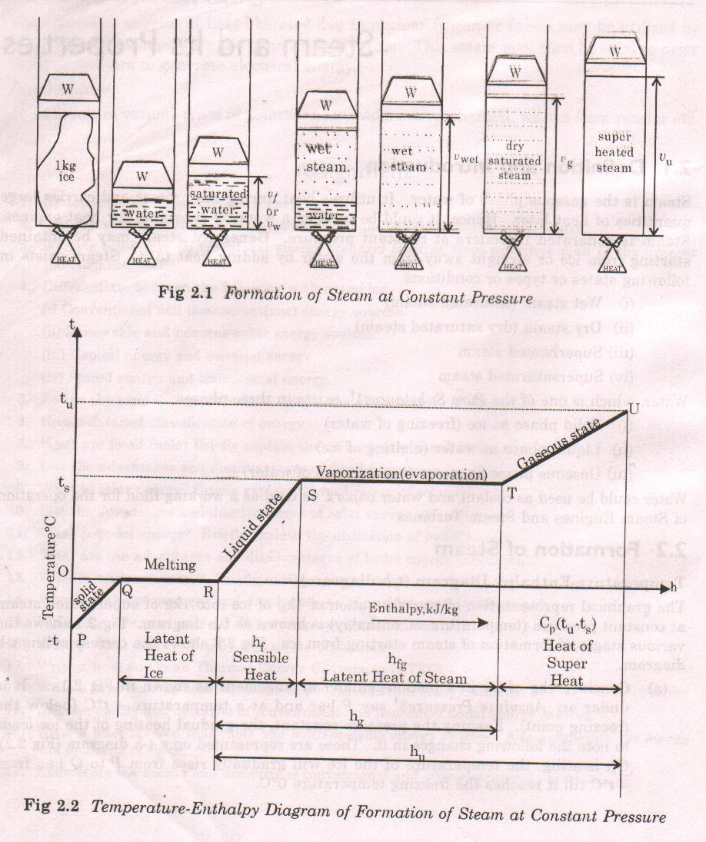

Slide 48
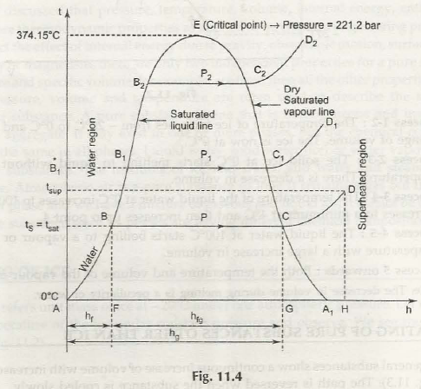
The point a
represents the initial
condition of water at 0◦c
and pressure P (in bar )
as shown in fig.
Line ABCD shows the
relation between temp
and heat at a specific
pressure of p(in bar).

Slide 49
During the formation of the superheated steam, from water at freezing point , the heat is absorbed in the following three stages
The heating of water up to boiling temperature or saturation temperature (t) is shown by ab in fig.

Slide 50
the heat absorbed by the water is AP , known as sensible heat or liquid heat or total heat of water.
The change of state from liquid to steam is shown by BC. The heat absorbed during this stage is PQ, known as latent heat of vaporization

Slide 51
The superheating
process is shown by
CD.The heat absorbed
during this stage is
QR, known as heat
of superheat.
Similarly, a family of
curves may be drawn for
different pressures as
shown in the fig.

Slide 52
The line passing through
the points A,B,E,K is
known as saturated
liquid line which forms
boundary line between
water and steam.
Similarly , a line passing
Through dry steam points
L,F,C is known as dry saturated
steam line which forms
boundary line between wet
and superheated steam.
It may be noted that from the fig., that when the pressure and saturation temperature increases , the latent heat of vaporization decreases. It becomes zero at a point (N) where liquid and dry steam line meets. This point N is known as the critical point .

Slide 53
The temperature corresponding to critical point N is known as critical temperature and the pressure is known as critical pressure.
For steam , the critical temperature is 374.15◦c and critical pressure is 221.2 bar.

Slide 54
Wet steam: when the steam contains moisture or particles of water in suspension , it is said to be wet steam.
Dry saturated steam: when wet steam is further heated and it does not contain any suspended particle of water, it is known as dry saturated steam.
Superheated steam: when the dry steam is further heated at a constant pressure, thus raising its temperature, it is said to be superheated steam.
Since the pressure is constant therefore volume of superheated steam increases, it may be noted that the volume of 1 kg of superheated steam is considerably greater than the volume of 1 kg of dry saturated steam at same pressure.

Slide 55
Dryness fraction or quality of wet steam: it is the ratio of the mass of actual dry steam ,to the mass of same quantity of wet steam.
It is generally denoted by ‘x’
Mathematically,
X= mg = mg
mg + mf m
Mg= mass of actual dry steam
Mf= mass of water in suspension
M = mass of wet steam

Slide 56
Sensible heat of water: it is amount of heat absorbed by 1kg of water , when heated at a constant pressure, from the freezing point (0◦c)to the temperature of formation of steam, i.e. saturation temp.
Latent heat of vaporization: it is amount of heat absorbed to evaporate 1 kg of water , at its boiling point or saturation temperature without change of temperature.
It is denoted by h(fg).
The latent heat of steam is 2257 kJ/kg at atmospheric pressure.

Slide 57
Enthalpy or total heat of steam: it is amount of heat absorbed by water from freezing point to saturation temperature plus heat absorbed during evaporation.
enthalpy= sensible heat+ latent heat
It is denoted by h(g)
For wet steam h= h(f)+ x h(fg)
Dry steam h=h(g)= h(f)+h(fg)
Superheated steam h(sup)= total heat for dry steam + heat for superheated steam .
=h(f)+h(fg)+Cp(t sup –t)
=h(g)+Cp(t sup- t)
Cp= mean specific heat at constant pressure for superheated steam
t sup= temp. of superheated steam
t= saturation temp at the given constant pressure.
The difference (t sup - t) is known as degree of superheat.

Slide 58
Specific volume of steam
It is the volume occupied by the steam per unit mass at a given temperature and pressure.
It is expressed in m3/kg.

Slide 59
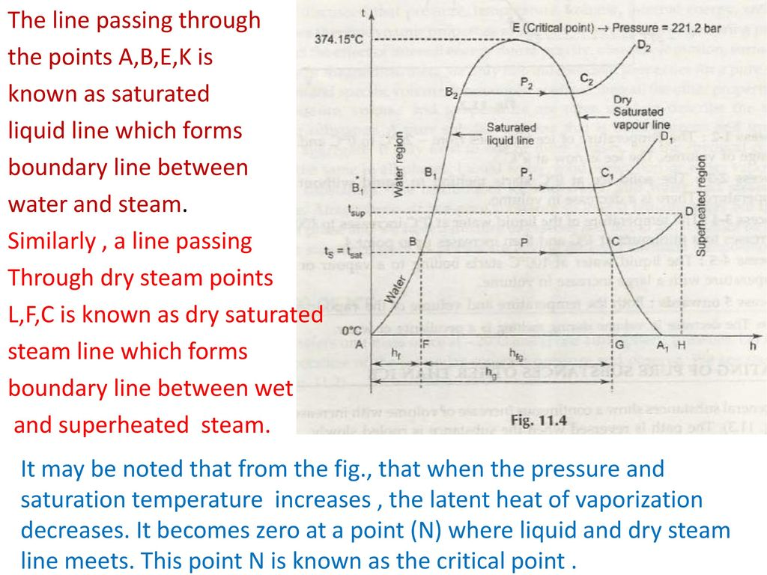

Slide 60
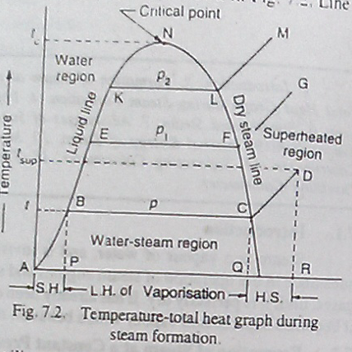
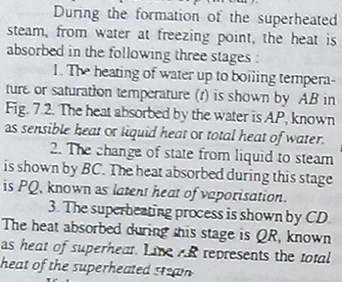
BME lecture week:1
-Heat graph of steam: Steam can be visible when pure and dry (above NLM line).
-At critical point, TN= 374.15°C, PN= 221.2bar,
-Heat can affect the curve in two ways:
1. state : same but Temperature : increases.
2. state : change but Temperature : constant.
S.H= sensible heat, t=boiling or saturation temperature (AB); and heat absorbed by water/total heat/liquid heat (AP).
L.H= latent heat (state 2),
H.S= heat of superheat. Point A= initial condition of H2O at 0°C and p pressure.
ABCD= T and heat at specific pressure p.
Page 199 to 204

Slide 61
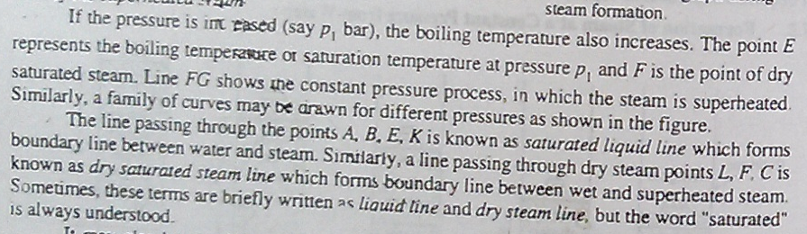
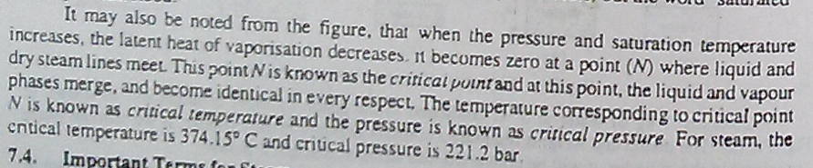
BME lecture week:1

Slide 62
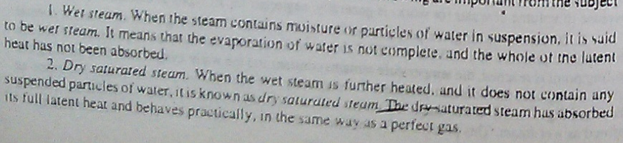
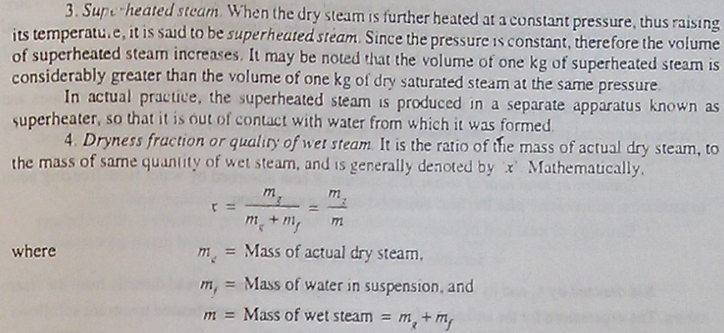
BME lecture week:1

Slide 63
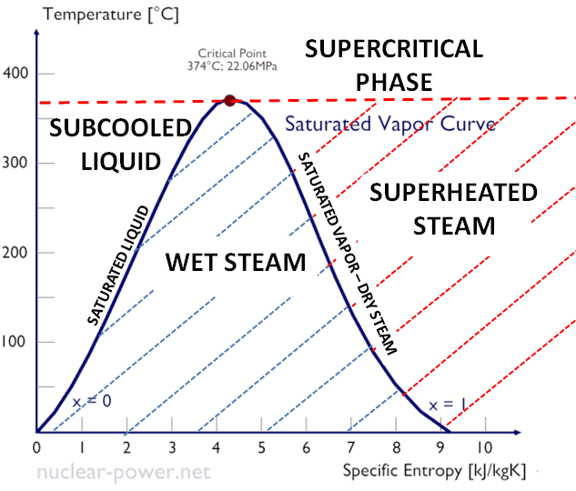

Slide 64
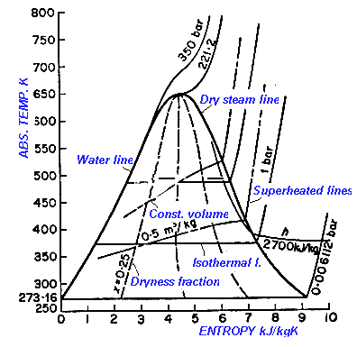

Slide 65
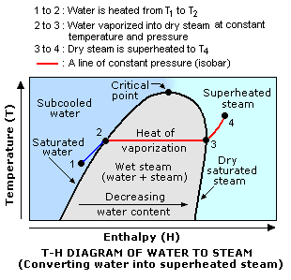

Slide 66
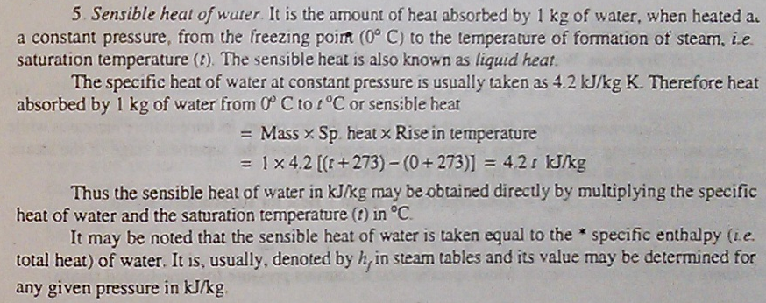
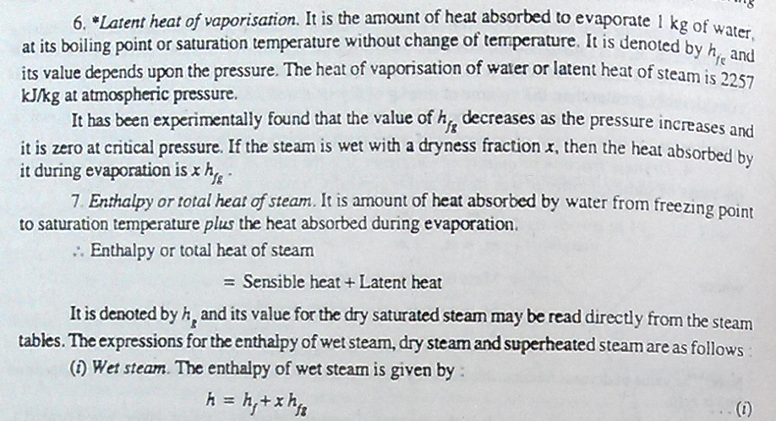
BME lecture week:1

Slide 67
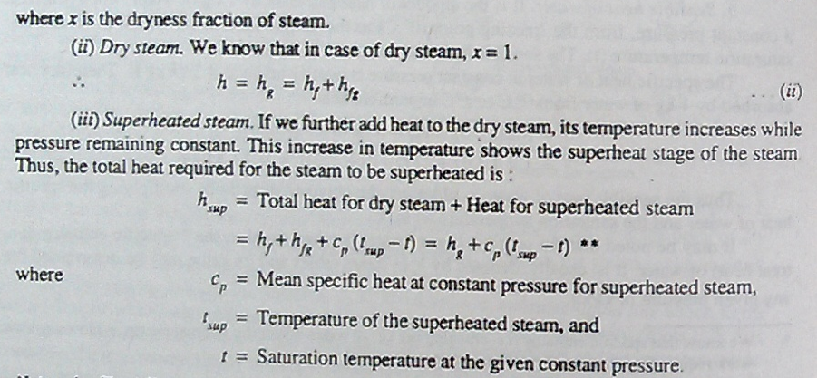
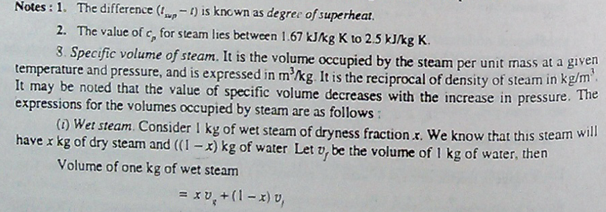
BME lecture week:1

Slide 68
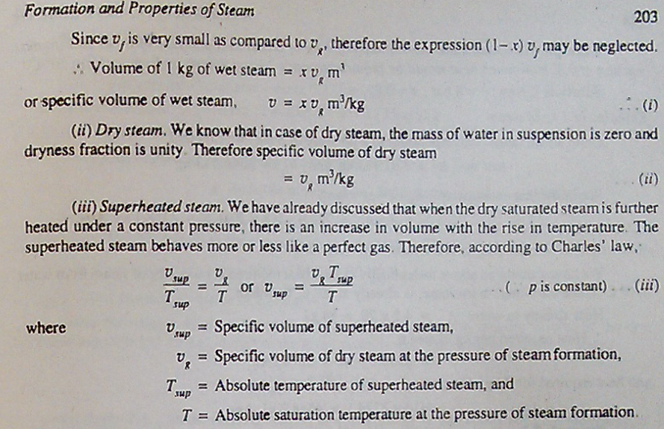
BME lecture week:1

Slide 69
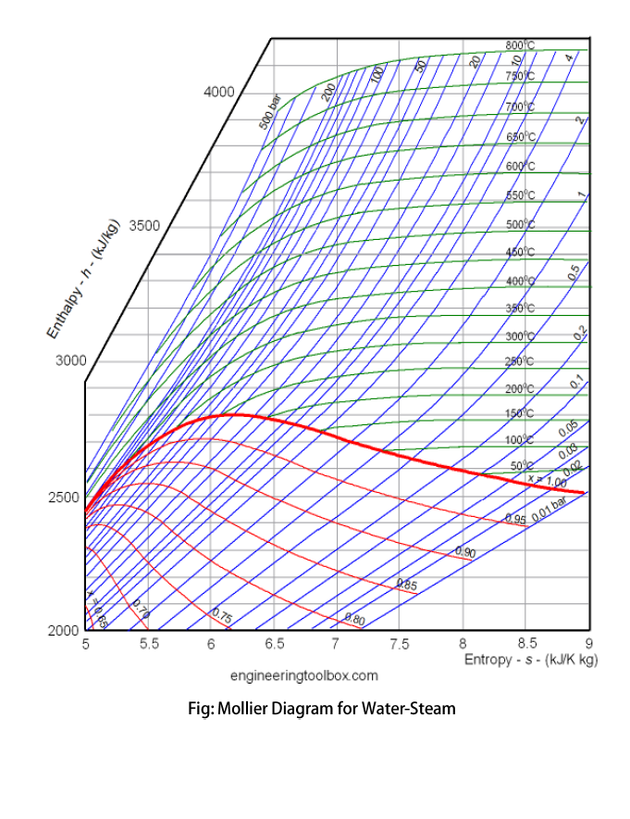
BME lecture week:1
Figure: Mollier H–S diagram

Slide 70
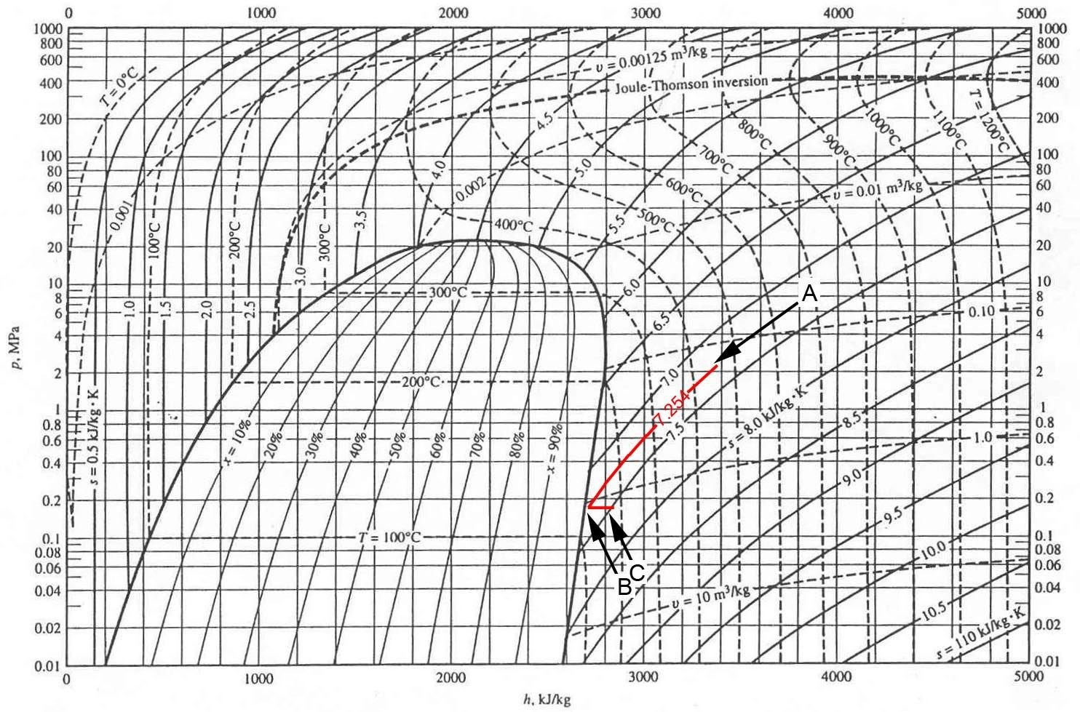

Slide 71
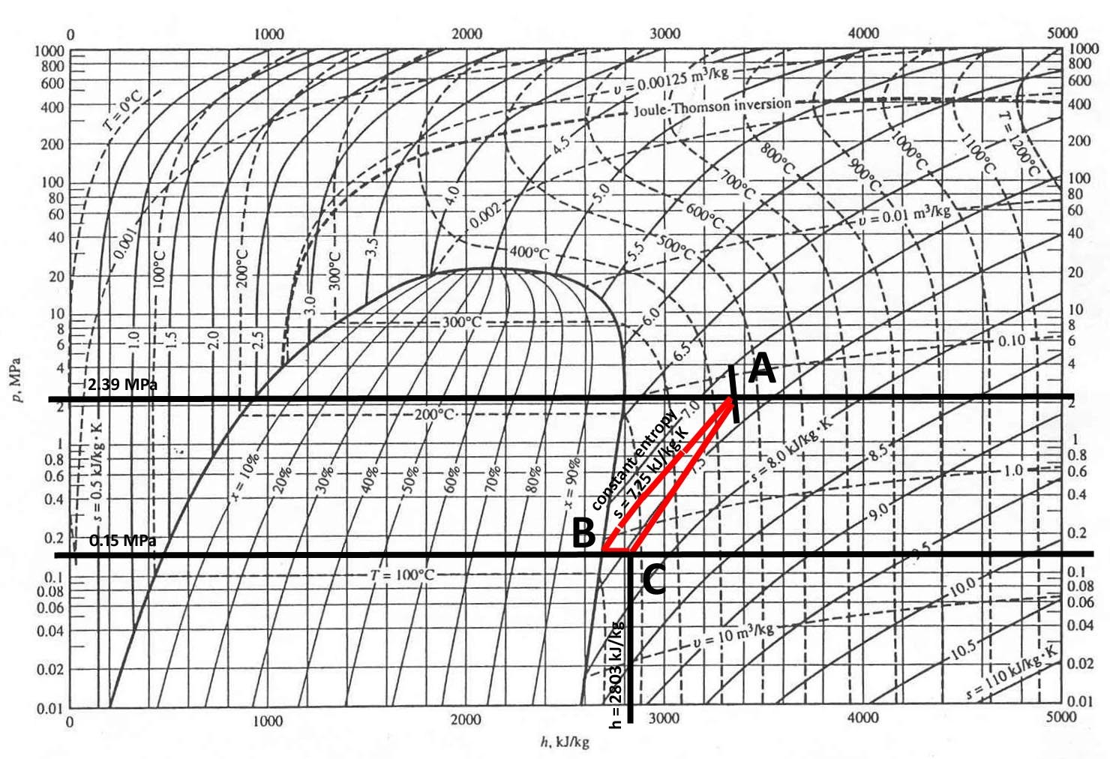

Slide 72
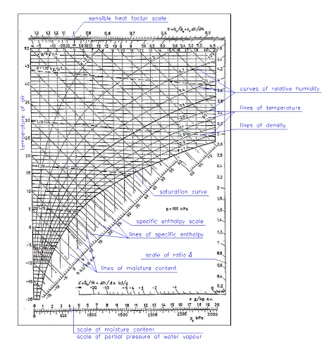
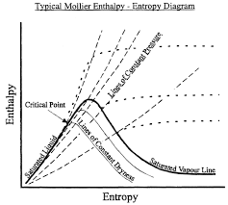

Slide 73
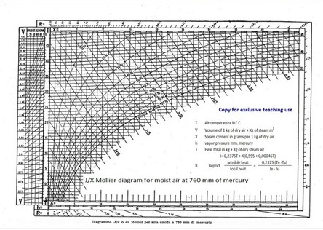

Slide 74
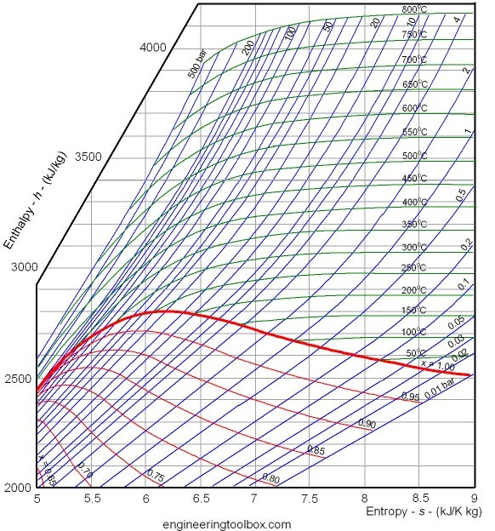

Slide 75
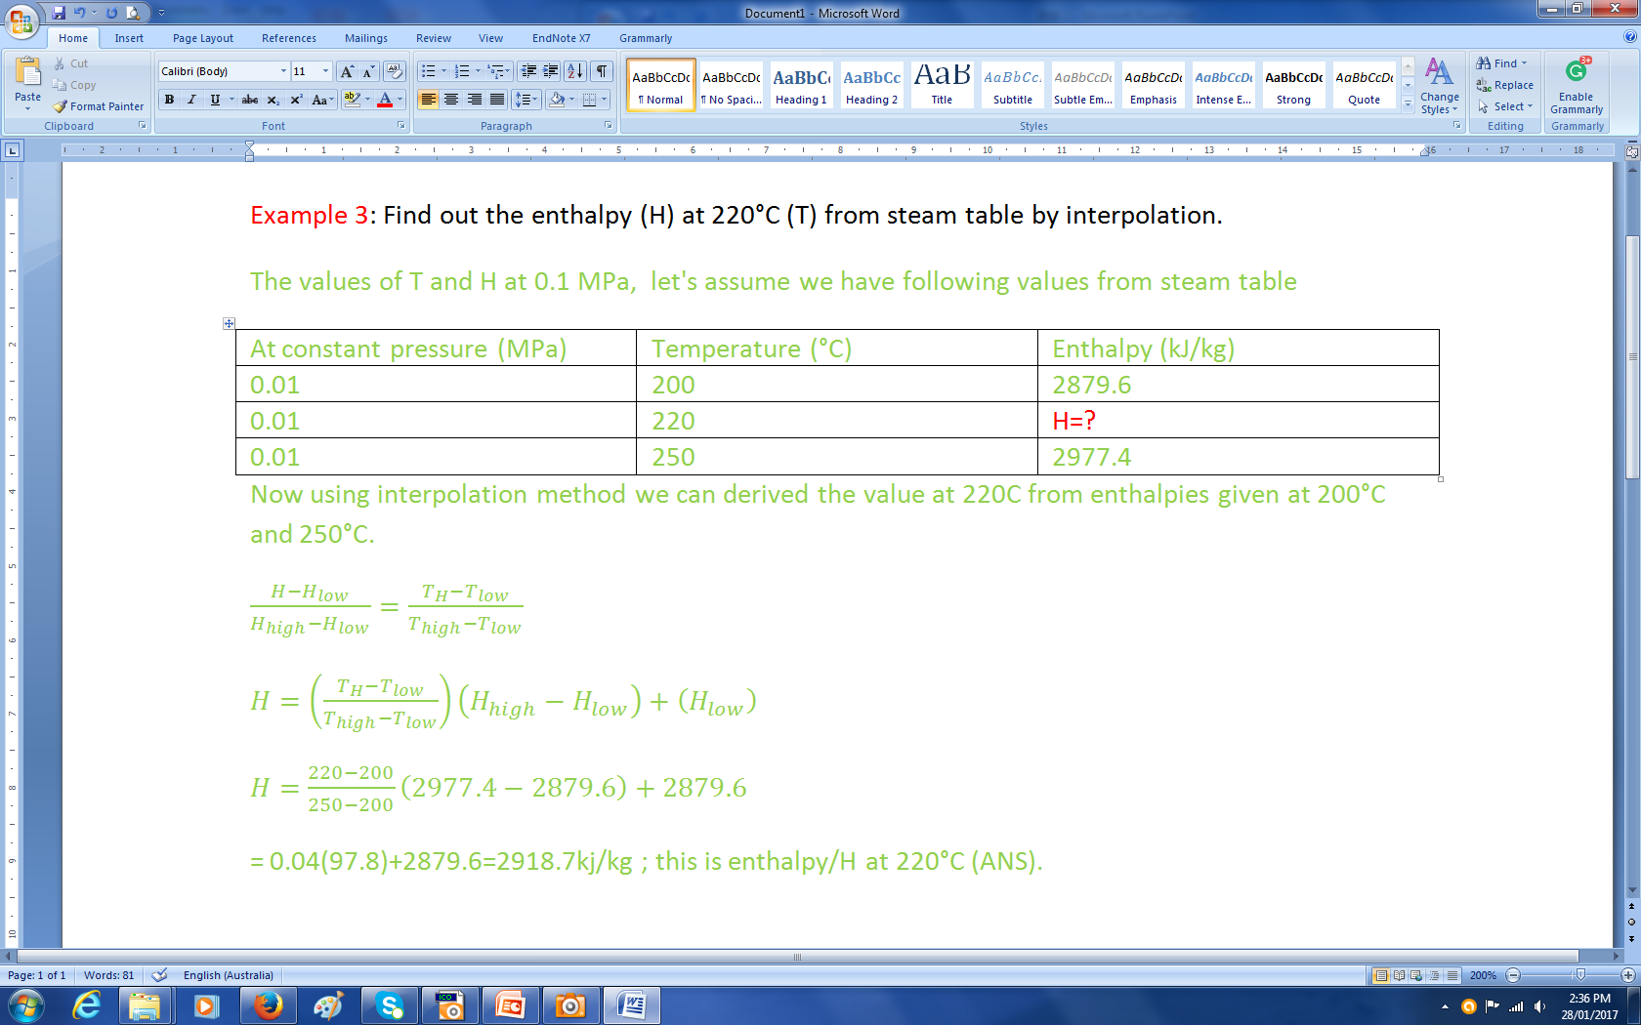
BME lecture week:1
Mollier diagram is named after Richard Mollier (1863-1935), a German professor who pioneered experimental research on thermodynamics associated with water, steam and water-vapor mixture. Mollier diagram is a graphical representation of a functional relationship between enthalpy, entropy, temperature, pressure and quality of steam. Mollier is often referred to as Enthalpy – Entropy Diagram or Enthalpy – Entropy Chart. They used commonly in the design and analysis associated with power plants, steam turbines, compressors, and refrigeration systems.
The constant pressure and constant temperature lines in the Mollier diagram are referred to as isobars and isotherms, respectively. In addition, the graph includes lines representing constant steam quality, “x,” in the bottom half of the diagram. The bold line, spanning from left to right, in the lower half of Mollier diagram is the saturation line. The saturation line, labelled as x = 1, represents the set of points on Mollier diagram where the steam is 100% vapor. All points above the saturation line are in the superheated steam territory. All points below the saturation line represent a mixture of liquid and vapor phases.

Slide 76
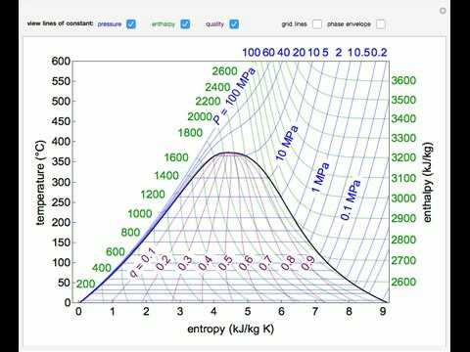
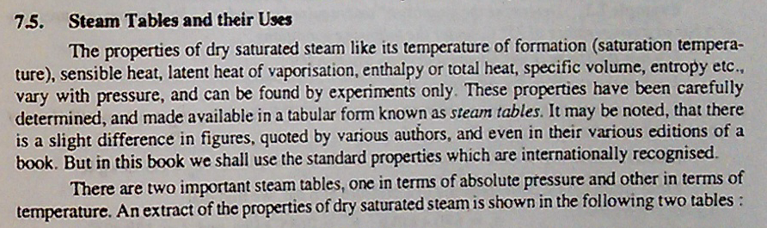
BME lecture week:1

Slide 77
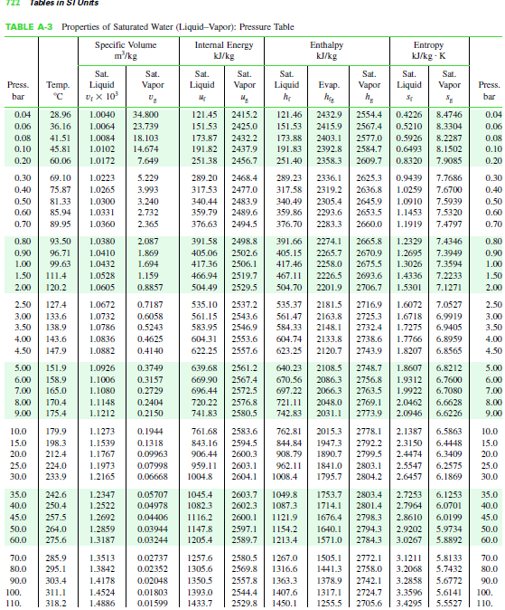
BME lecture week:1

Slide 78
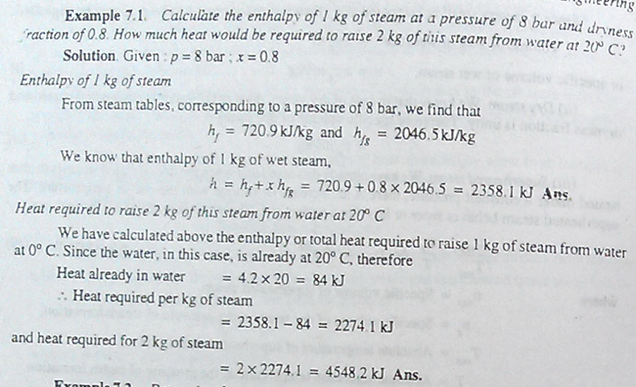
BME lecture week:1

Slide 79
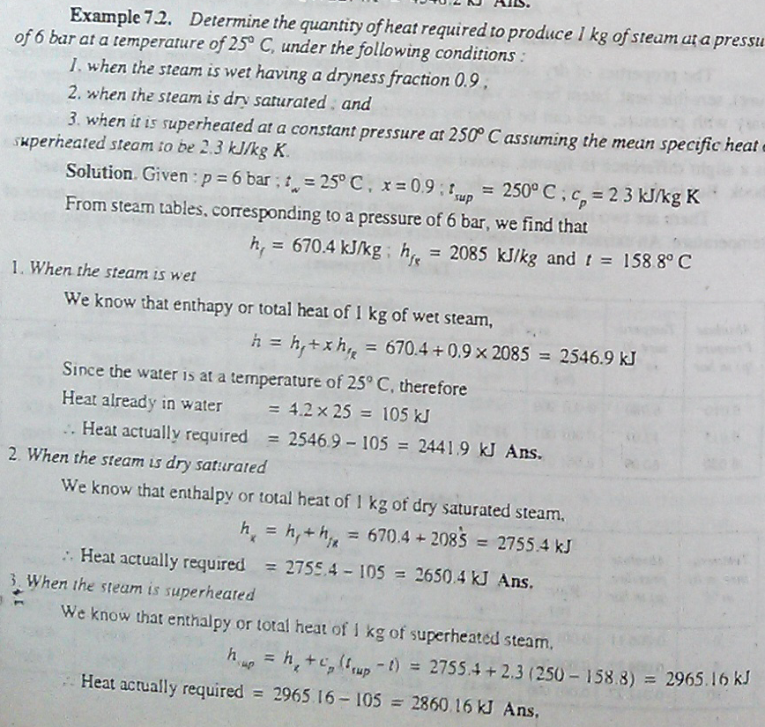
BME lecture week:1

Slide 80
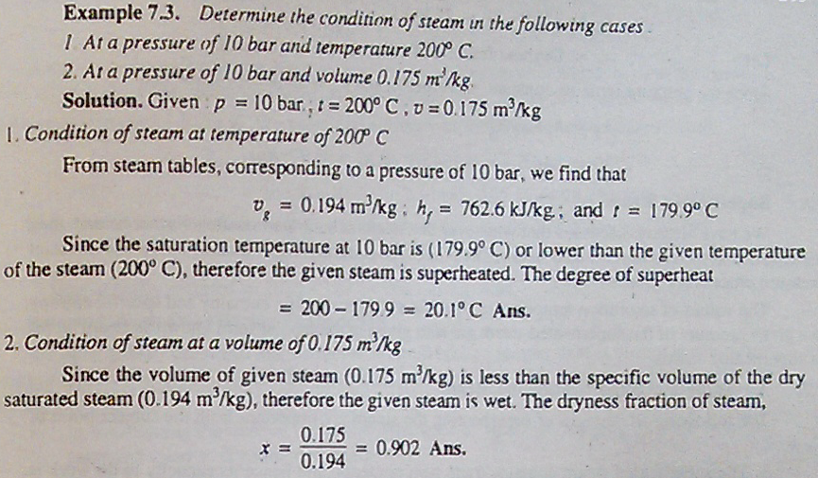
BME lecture week:1

Slide 81
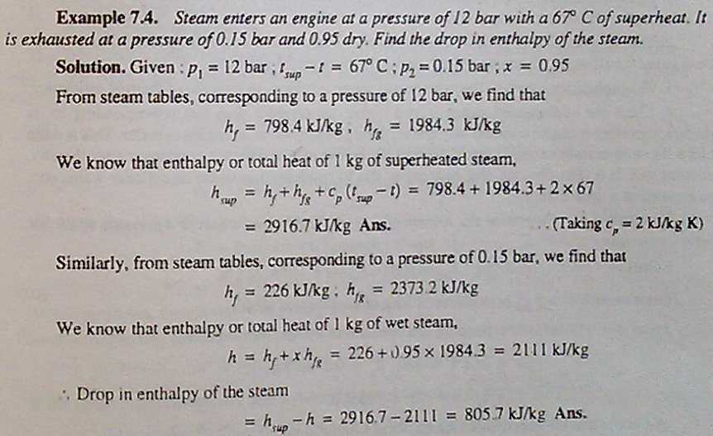
BME lecture week:1

Slide 82
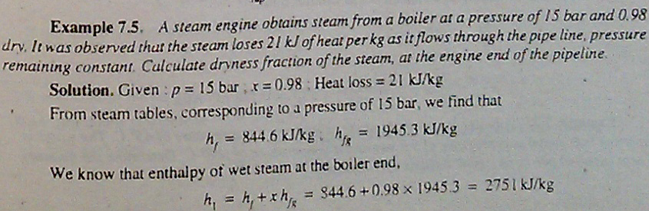
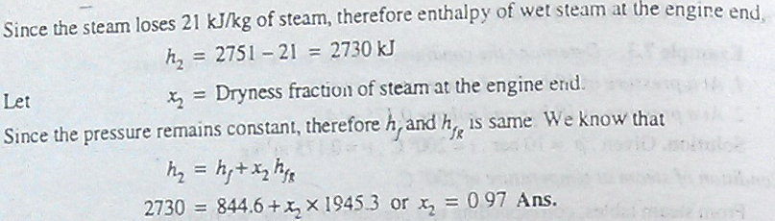
BME lecture week:1

Slide 83
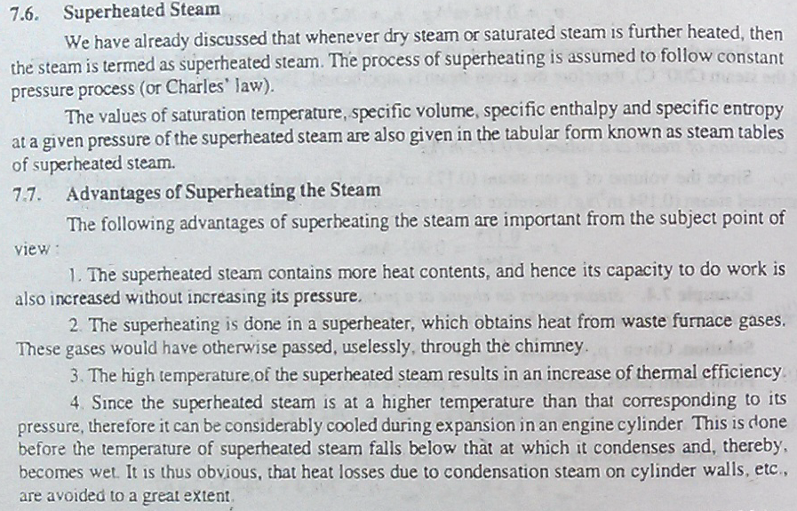
BME lecture week:1

Slide 84
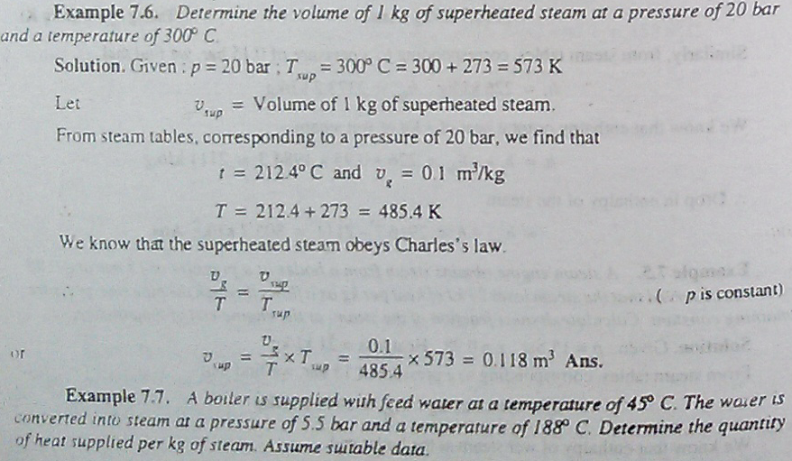
BME lecture week:1

Slide 85
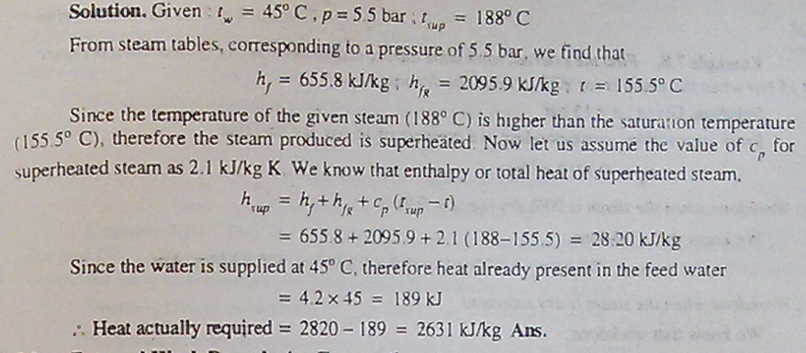
BME lecture week:1

Slide 86
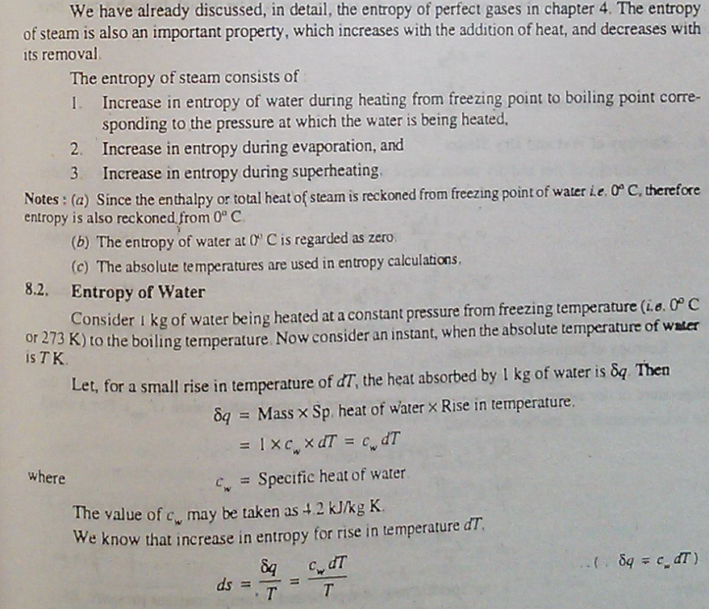
BME lecture week:1

Slide 87

BME lecture week:1

Slide 88


BME lecture week:1

Slide 89

BME lecture week:1
= Isenthalpic lines

Slide 90
BME lecture week:1

Slide 91

BME lecture week:1

Slide 92


BME lecture week:1
4, 3, 0.5 bar and 200C

Slide 93
BME lecture week:1

Slide 94
BME lecture week:1
Thank you for your attention

